Slide 1
High-Risk Project
Derek Burrola
Retinal image classification in the Transformer Age

Slide 2
Contents
1.
Introduction
2.
Data
3.
Training
4.
Results
5.
Benefits of ViT
6.
Conclusion
Code available: GitHub

Slide 3
Introduction
Retinal disease classification using Visual Transformer
Notes:
This high-risk project focus on the classification of retinal diseases on images of eyes by using visual transformers.

Slide 4
Introduction (breakdown)
Ophthalmologist shortage
Google’s gender detection in eyes
Phones with cameras
Notes:
The reason for this project idea has been a passion project of mine for a few years.
After Google announced that their AI system had been able to detect male or female based on just a picture of the fundus of the eye with 97% accuracy it lead me to think that there must be other subtle differences hidden away in the eyes that are too subtle for a human to detect.
This lead me to start researching AI and how AI systems could be leveraged to detect diseases early on and hopefully one day detect diseases that we were not aware could be detected through the eyes.
There is a massive shortage of Ophthalmologists, which are the doctors who specialize in eyes. My goal outside of this project is to be able to build a model that can allow users to take a picture of their eyes at home, even through their smart phone and be able to get an accurate preliminary diagnosis of any potential diseases they may need to go get bloodwork for. As of now many people develop diseases without knowing and they aren’t caught until they become an issue. My goal is to make a model that you can spend less than minute on a month or even a year and you’ll know if there are any chances that you may be developing a disease. This can prompt a person to go to the doctor to and proper blood work can be done without the need of symptoms that typically lead a person to visit the doctor.

Slide 5
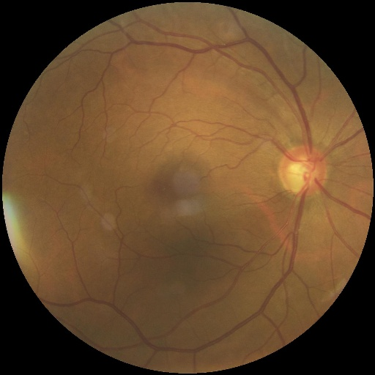
Data Collection
1
2
3
Dataset
Resizing
Normalization
Eye Diseases Classification Dataset
Resize to model specifications
Normalize RGB colors of image
224x224
Notes:
The dataset selected was based on research done on a previous project where I attempted this same idea using CNNs. The data I had was not well-balanced, my implementation was lacking & I was able to find a project on GitHub of someone who attempted the same thing I had done, but with valid success. I went through their implementation and ideology. I decided this would be the comparison. I used the same dataset that this GitHub repo since it was well-balanced, focused on 3 classes (Glaucoma, Diabetes, Cataracts) and a control group (Normal). They contain about 1,000 of each class which made it be enough data to work with.
The data was already well-balanced, no clean up was needed. The images were resized to 224x224 to accommodate the model and then they were all normalized to prevent any highs or lows in the RGB image from leading to outlandish results

Slide 6
Model Training
ViT Model
CrossEntropyLoss
AdamW
CosineAnnealingLR
Pre-Trained Model
Notes:
For our model’s training we used Cross Entropy Loss to classify multiple diseases.
We used AdaW and CosineAnnealignLR to get customizable learning rates during training
We used a pre-trained ViT model that we used as our base with 50% of its layers frozen

Slide 7
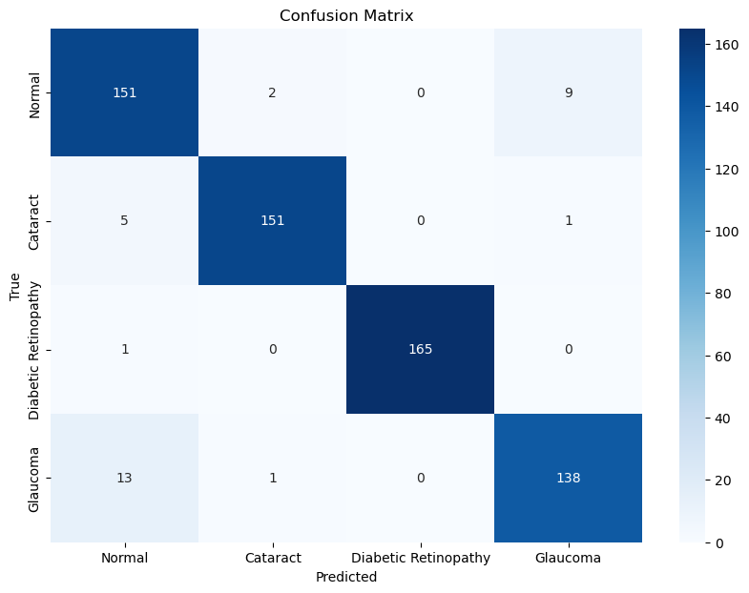
Results
Class
Precision
Recall
F-1 Score
Normal
Cataracts
Diabetic
Retinopathy
Glaucoma
0.88.82
0.9805
1.0
0.9324
0.9321
0.9618
0.9940
0.9079
0.9096
0.9711
0.9970
0.9200
Notes:
The results here show impressive performances for the ViT model.
The confusion matrix on the left shows very few false positive or false negatives predicted by the model
While the table on the right shows impressive precision, recall, and f-1 scores for all classes.

Slide 8
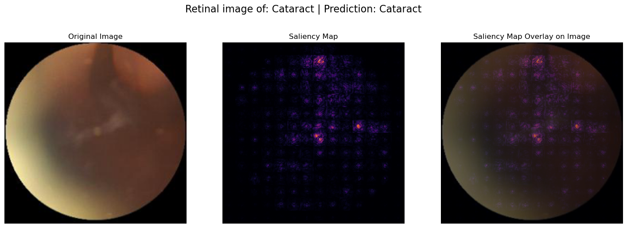
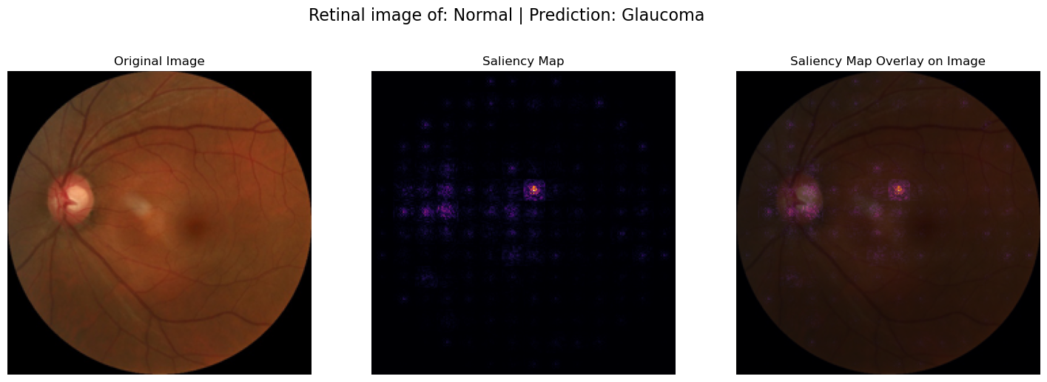
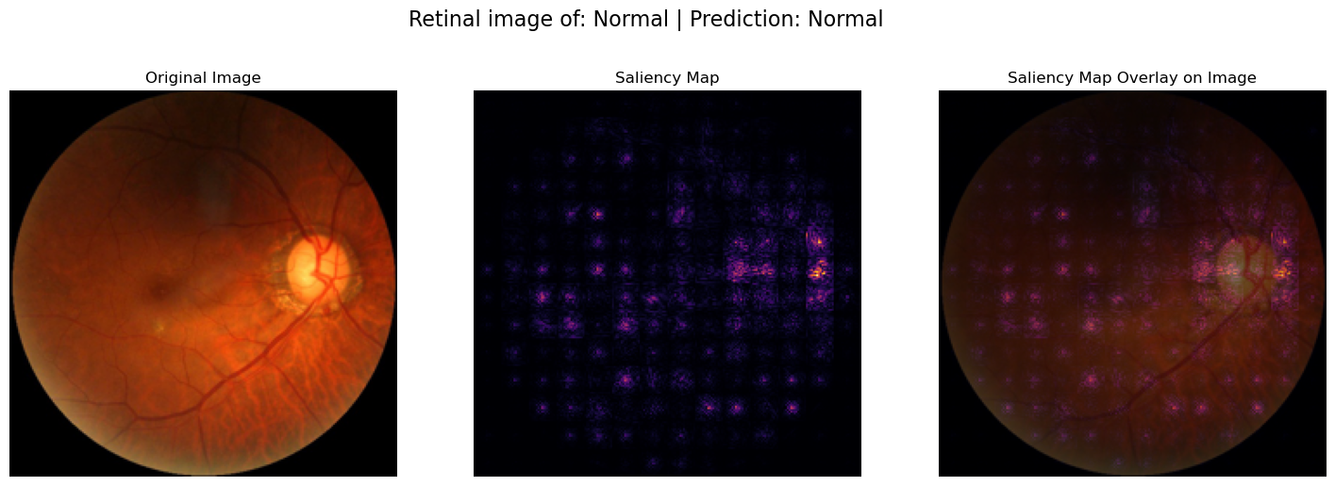

Benefits of ViT
Attention Mechanism
“Understanding” into black box
Notes:
One of the major benefits to using Vision transformers is the ability to have a salience map for the image.
Since transformers were made for text encoding, the include an attention mechanism.
When used with images, these attention mechanisms allow us to clearly see what areas of the image the model is giving focus to.
The images on the right provide the original image, the salience map generated by the model and then an overlay of the salience map over the image.
This simple feature allows us to see where the model is finding its information and that can allow professionals to quickly detect abnormalities in a short amount of time.

Slide 9
Conclusion
Fast results
Easy to train
High performance
Fast way to get a preliminary diagnosis
Using a pre-trained ViT model, easy and inexpensive to train
Outperformed CNN model
80% -> 94.98%
Notes:
The model trained is very fast at providing results which makes this a viable alternative for a preliminary eye screening in regards to these 3 diseases. Shows potential to be used further to enhance patient and doctor visitations.
The model is easy to train, does not require too much data and it is relatively cheap to train. This model was train on a RTX 4070 12GB card and trained for 7 epochs in about 3 minutes.
The performance is high when compared to the CNN model with the same dataset.

Slide 10
Thank you

